Slide 1
CS 682 – Software Development Lab
Lecture 2 – Agile Software Development / Requirements
_{Fall 2023}

Slide 2
Agile Software Development

Slide 3
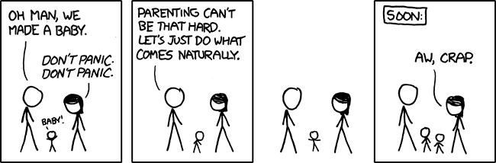
Agile – What is it?
Aligned with how we actually make software
  Think about the problem for a bit
  Come up with a solution
  Write code
  Adjust as needed
  Repeat…
Doing what comes naturally….

Slide 4
Principles Behind Agile Development
Deliver valuable software early and often
Welcome changing requirements - even late in the development process
Business people and developers must work together daily throughout the project.
Build projects around motivated individuals
Communicate face-to-face
Working software is the primary measure of progress.
Agile processes promote sustainable development.

Slide 5
Agile vs Scrum
Agile
  Abstract description of the software development
Scrum
  Concrete implementation of agile

Slide 6
Scrum – Requirements Gathering
User stories
  Customer “tells a story”
  Non-technical
  example: “When I check a piece of equipment, I want to know all the information about it.”
Tasks
  Technical requirements needed for stories
  example:
    host a database of equipment information
    track equipment with barcodes
    convert scanned codes into SQL queries
    display query results to the user

Slide 7
Scrum - Sprints
Deliver working code at fixed intervals
  Sets a pace for the project
  Typically 2-4 weeks/sprint
After each sprint
  Demo the software to the customer
  Discuss the direction of the project
  Adjust as needed

Slide 8
Scrum – Putting it all together
Gather requirements
  Customer: “This is what we want”
  Development team: “Got it. See you in two weeks!”
Write code
Deliver code
  Customer: “This isn’t what we wanted”
  Development team: “Ok. Show us what you want”
Revise requirements
Write code
Deliver code
  Customer: “This is a little better”
  Dev team: “Cool. Tell us more”
Revise requirements
Repeat …..

Slide 9
Scrum Board
Visualization of the state of the project
Column for the state of each task
  backlog/blocked/task
  in progress
  testing
  complete
Move tasks across the board as they progress
Column names vary by team

Slide 10
Requirements Analysis

Slide 11
Requirements Analysis and Definition
The requirements analysis and definition establish the system's services, constraints and goals by consultation with users. They are then defined in a manner that is understandable by both users and development staff.
This phase can be divided into:
  Requirements analysis
  Requirements definition
  Requirements specification
Requirements define the function of the system FROM THE CLIENT'S VIEWPOINT.

Slide 12

What does the Customer Say?

Slide 13
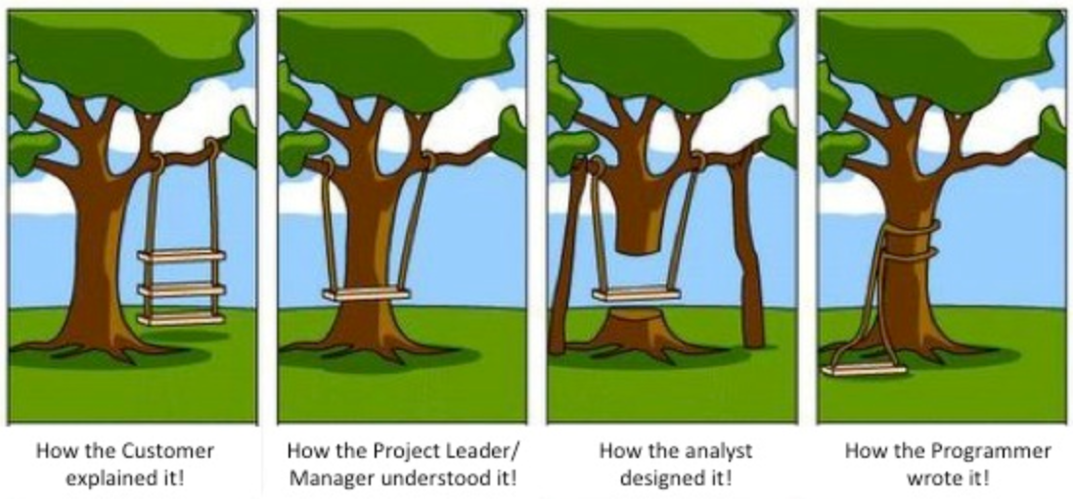
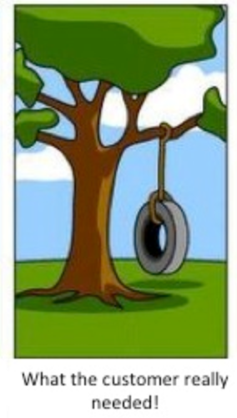
Why are Requirements Important?

Slide 14
Why are Requirements Important? – cont’d
Causes of failed software projects (Standish Group study, 1994)
  Incomplete requirements 13.1%
  Lack of user involvement 12.4%
  Lack of resources 10.6%
  Unrealistic expectations 9.9%
  Lack of executive support 9.3%
  Changing requirements & specifications 8.8%
  Lack of planning 8.1%
  System no longer needed 7.5%
Failures to understand the requirements led the developers to build the wrong system!
Source: Standish Group, 1994

Slide 15
Goals During the Requirements Phase
Understand the requirements in detail (analysis).
Describe the requirements in a manner that is clear to the client. Ensure that the client understands the description of the requirements and their implications.
Describe the requirements in a manner that is clear to the people who will design and implement the system.
The Requirements Documentation is the defining document that describes the goals of the system that is being built.
It may form a legal contract between client and software developers.

Slide 16
The Requirements Process
Feasibility Study
Requirements Analysis
Requirements
Model
Feasibility
Report
Requirements Specification
Work with the client to understand the requirements
Organize the requirements in a systematic and comprehensible manner
Documentation of
Requirements
Requirements Analysis

Slide 17
Requirements Analysis
High-level abstract description of requirements:
  Specifies external system behavior
  Comprehensible by customer, management and users
Should reflect accurately what the customer wants:
  Services that the system will provide
  Constraints under which it will operate
Often described in a separate document for consultation with the client.
"Our understanding of your requirements is that ...“
Should define the boundaries of the system

Slide 18

Requirements Analysis – Defining the Boundary

Slide 19

Requirements Analysis – Defining the Boundary

Slide 20

Requirements Analysis – Defining the Boundary

Slide 21
Requirements Analysis: Interviews
Client interviews are the heart of the requirements analysis.
Clients may have only a vague concept of requirements.
  Allow plenty of time.
  Prepare before you meet with the client.
  Keep full notes.
  If you do not understand, delve further, again and again.
  Repeat what you hear.
  Small group meetings are often most effective

Slide 22
Requirements Analysis: Process
Identify the stakeholders: Who is affected by this system?
  Client
  Senior management
  Production staff
  Computing staff
  Customers
Understand the requirements in depth:
  Domain understanding
  Understanding of the real requirements of all stakeholder
  Understanding the terminology
Organize the requirements
  Classification into coherent clusters
  Recognize and resolve conflicts

Slide 23
Requirements Analysis: Viewpoint Analysis
Analyze the requirements as seen by each group of stakeholder.
Example: University Admissions System
  Applicants
  University administration
    Admissions office
    Financial aid office
    Special offices (e.g., athletics, development)
  Computing staff
    Operations
    Software development and maintenance
  Academic departments

Slide 24
Requirements Documentation
The form of documentation varies, but is likely to contain the following:
General:
  Purpose and scope of system
  Objectives and criteria for success
  List of terminology, organizations involved, etc.
Description of current system(s)
Requirements of proposed system:
  Overview
  Functional Requirements
  Usability requirements
  Non-functional requirements

Slide 25
Requirements Documentation – cont’d
System models:
  Scenarios
  Use cases
  Models used during analysis
Detailed specifications:
  Business rules, specifications, etc. (e.g., reference to an accounting standard)
  Data flow, sources of data, data validation
  etc., etc.,
A common fault in requirements documentation is to gloss over the details. This results in misunderstandings between the client and the developers.

Slide 26
Realism and Verifiability
Requirements must be realistic, i.e., it must be possible to meet them.
Not: The system must be capable of x, if no known computer system can do x at a reasonable cost.
Requirements must be verifiable, i.e., it must be possible to test whether a requirement has been met.
Wrong: The system must be easy to use.
Right: After one day's training an operator should be able to input 50 orders per hour.

Slide 27
Requirement Types: Functional Requirements
Requirements about the functions that the system must perform that will be identified by analyzing the use of the system
Functionality
Data
User interfaces

Slide 28
Requirement Types: Non-Functional Requirements
Requirements that are not directly related to the functions that the system must perform
Usability, documentation and training
Reliability and quality assurance
Performance
Supportability
Implementation and technical constraints
Interfaces and compatibility
Operation and physical environment
Packaging and security
Legal and business
Resources

Slide 29
Requirement Specification – Documentation
Reasons for documentation:
  visibility (e.g., project plan, interim report)
  user support (e.g., user manual)
  team communication (e.g., interface specifications)
  maintenance and evolution (e.g., requirements)
Characteristics of documentation:
  accurate and kept current
  appropriate for audience
  maintained online (usually)
  simple but professional in style and appearance
Documentation is expensive --> Quality not volume

Slide 30
Requirements Specification: Purpose
Document that describes the requirements to the stakeholders in a precise manner
  Expressed in the terms that the stakeholders understand
  As precise and specific as possible
  Comprehensible from many viewpoints
  Reviewed by stakeholders so that they understand implications
  Must be clear about assumptions (things left out)
It describes the requirements to the implementers
  As precise and specific as possible
  Expressed in terms that they understand
  Comprehensible to new team members

Slide 31
Requirements Specification: Purpose
It records the requirements for the future
  An essential part of system evolution
  It may be a contractual document

Slide 32
Details in Requirements
Requirements must be specific
Requirements must be comprehensive to cover all unintended features
Examples -- university admissions system
  Requests for information received by email must be answered within one business day.
  An admissions officer who is talking to an applicant by telephone must be able to retrieve the applicant's records within 10 seconds.
  No financial aid offer may exceed the maximum defined in Section 8.7.

Slide 33
Details in Requirements: Example of an Ambiguous Specification
During a laser experiment, a laser beam was directed from earth to a mirror on the Space Shuttle Discovery. The laser beam was supposed to be reflected back towards a mountain top 10,023 feet high.
The operator entered the elevation as “10023” but the light beam never hit the mountain top. What was the problem?
The computer interpreted the number in miles...

Slide 34
Details in Requirements: Example of an Unintended Features
From the News: London underground train leaves station without driver!
What happened?
A passenger door was stuck and did not close so the driver left his train to close the passenger door.
He left the driver door open relying on the specification that said: the train does not move if at least one door is open
When he shut the passenger door, the train left the station without him
The driver door was not treated as a door in the source code!

Slide 35
End

